Slide 1
Individual Project: Comparative Intelligence and Ethics in Machine Learning Systems

Slide 2
Executive summary
The exercise compares a classical machine learning algorithm (linear regression) and a deep learning model (multi-layer perceptron).
The model uses MovieLens 1M dataset.
The comparative analysis found that the deep learning path yields a more accurate model (the deep learning model attains a lower RMSE and MAE and a higher R2 than the classical ML model).
This outcome is consistent with expectation, as the former learns the taste of each individual user and movie directly from the ratings, whereas the latter relies on a small number of summary features.

Slide 3
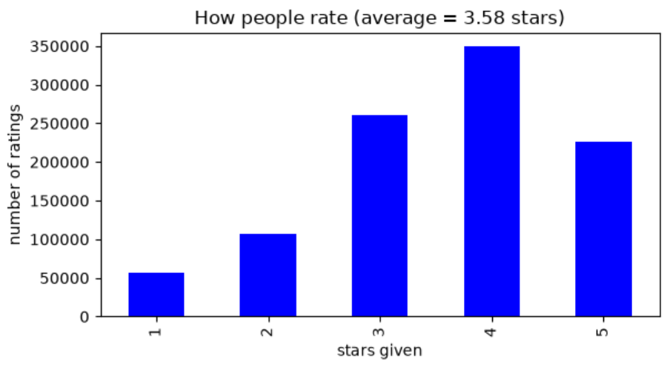
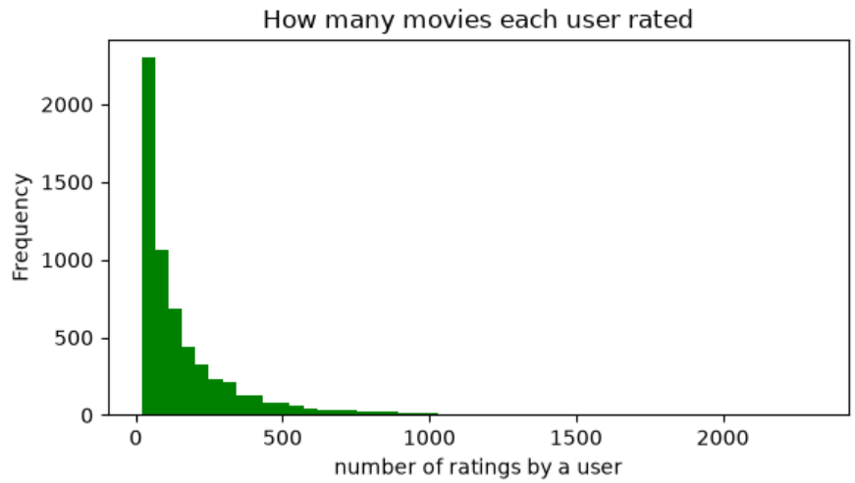
Data selection and exploratory data analysis
Hegde, M. (2026) “Summative Assessment: Individual Presentation,” ML_PCOM7E April 2026. Jupyter Notebook submitted to the University of Essex Online.

Slide 4
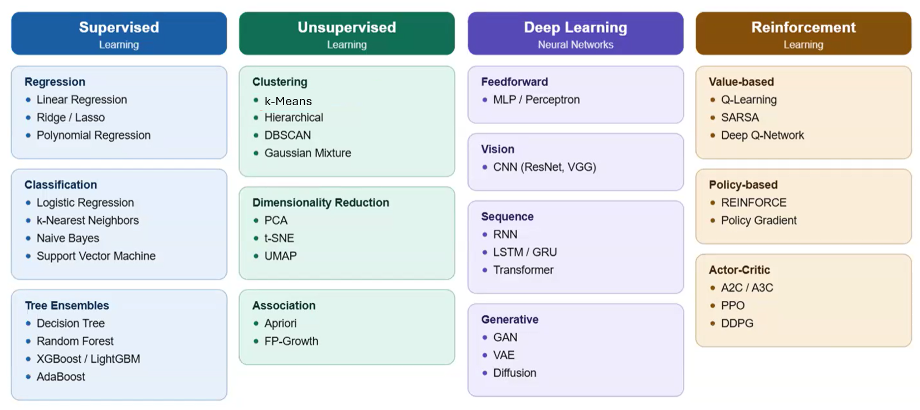
Model selection
University of Essex (2026) “Unit 4 Seminar: Linear Regression with Scikit-Learn,” ML_PCOM7E April 2026. Unit 4 Seminar.
University of Essex (2026) “Unit 6 Seminar: K-Means Clustering Tutorial,” ML_PCOM7E April 2026. Unit 6 Seminar.
University of Essex (2026) “Unit 8 Seminar: Comparing Machine Learning, Deep Learning and Ethical Impact in Practice Seminar Preparation Tasks,” ML_PCOM7E April 2026. Unit 8 Seminar.

Slide 5
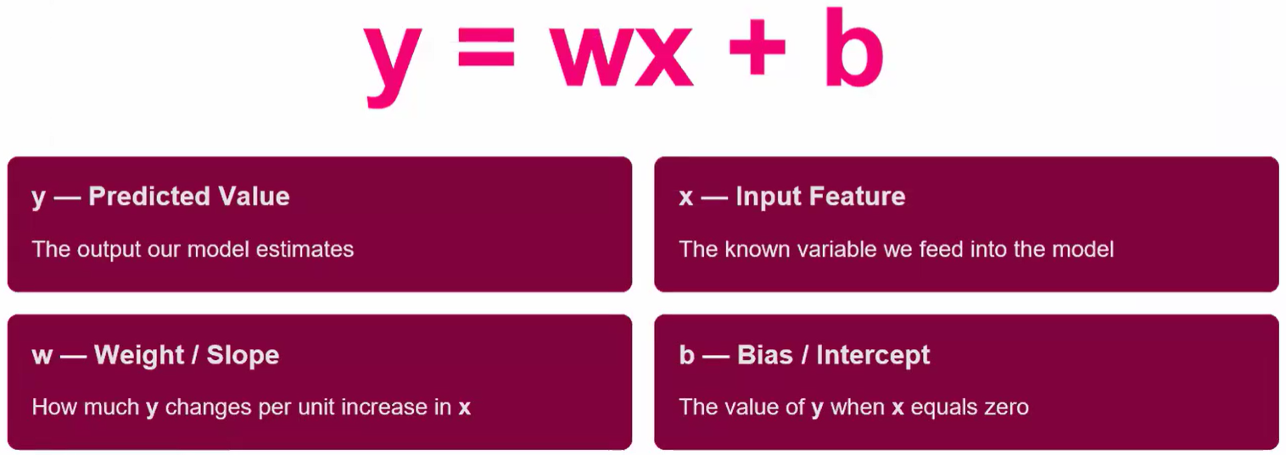
Feature engineering
University of Essex (2026) “Unit 4 Seminar: Linear Regression with Scikit-Learn,” ML_PCOM7E April 2026. Unit 4 Seminar.

Slide 6
Feature engineering
23 features:
user_avg: the mean rating historically given by the user.
movie_avg: the mean rating historically received by the movie.
gender, age, year: basic user demographics and the release year of the film.
Genre: each genre is represented by its own binary column indicating whether the film belongs to that category. We will use multi-hot rather than one-hot encoding as a film can belong to several genres at once (for example, Animation, Children's, and Comedy).
Hegde, M. (2026) “Summative Assessment: Individual Presentation,” ML_PCOM7E April 2026. Jupyter Notebook submitted to the University of Essex Online.

Slide 7
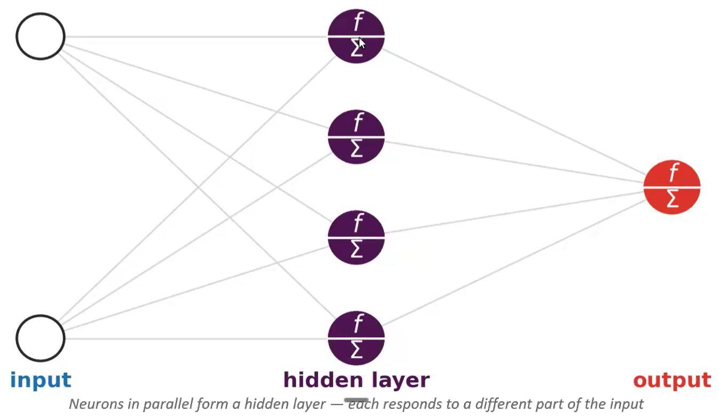
Feature engineering
University of Essex (2026) “Unit 8 Seminar: Comparing Machine Learning, Deep Learning and Ethical Impact in Practice Seminar Preparation Tasks,” ML_PCOM7E April 2026. Unit 8 Seminar.

Slide 8
Evaluation metrics and validation strategy
90% - training and validation
10%
test
Source dataset
5-folds, 20% of training dataset in each
Hegde, M. (2026) “Summative Assessment: Individual Presentation,” ML_PCOM7E April 2026. Jupyter Notebook submitted to the University of Essex Online.

Slide 9
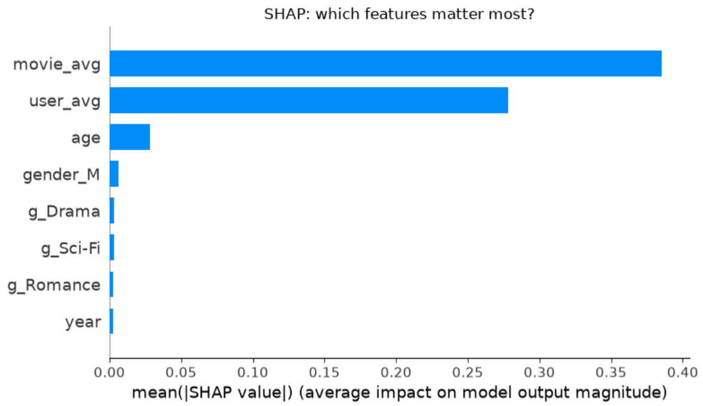
Explainability
Hegde, M. (2026) “Summative Assessment: Individual Presentation,” ML_PCOM7E April 2026. Jupyter Notebook submitted to the University of Essex Online.
Topol E. (2019) Deep Medicine: How Artificial Intelligence Can Make Healthcare Human Again. Basic Books.

Slide 10
Ethics and bias
Popularity bias
Cost of errors
Fairness
Sampling bias

Slide 11

Ethics and bias
Cat
Tigers
Tiger (high confidence)
Cows

Slide 12
Deployment considerations
Training
Inference
Scalability
Monitoring
Model deployment options in Amazon SageMaker AI - Amazon SageMaker AI (no date). Available at: https://docs.aws.amazon.com/sagemaker/latest/dg/how-it-works-deployment.html (Accessed: July 13, 2026).
Deploy Machine Learning Models to Online Endpoints - Azure Machine Learning | Microsoft Learn (no date). Available at: https://learn.microsoft.com/en-us/azure/machine-learning/how-to-deploy-online-endpoints?view=azureml-api-2&tabs=cli (Accessed: July 13, 2026).

